Slide 1
BROCHURES
Fouzia Jamal Goreja
Assistant Professor

Slide 2
DEFINITION
Brochures are printed publications that promote the products and services offered by a business or that promote the image of a business or an organization by providing general or specific technical information important to a target audience.
The goal of a brochure is to inform or to persuade or to do both.

Slide 3
Types of Brochures
The two major types of brochures are
Sales brochures
Informational brochures.

Slide 4
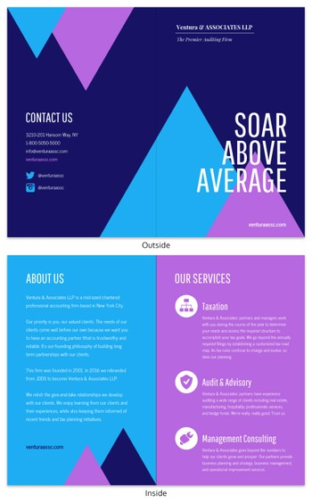
Sample brochure

Slide 5
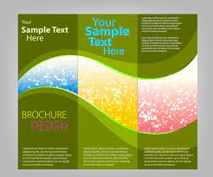
Sample brochure

Slide 6
Sales brochures
These are created specifically to sell a company’s products and services.
A technically oriented sales brochure can promote the performance data of various models of a product or list the benefits or capabilities of different types of equipment available for specific jobs.
For example, the brochure of a microwave oven manufacturer might describe the various models and their accessories and how the ovens are to be installed over stove tops.

Slide 7
Informational brochures
These are created to inform and to educate the reader as well as to promote goodwill and to raise the profile of an organization.
For example, an informational brochure for a pesticide company might show the reader how to identify various types of pests like silverfish and termites, detail the damage they can do, and explain its harmful effects.

Slide 8
Designing the Brochure
Before you begin to write, determine the specific purpose of the brochure—to provide information about a service? to sell a product?
You must also identify your target audience—general reader? expert? potential or existing client?
Understanding your purpose, audience, and context is essential to creating content and a design that will be both appropriate and persuasive to your target audience.

Slide 9
Cover Panel.
The main goal of the cover panel is to gain the audience’s attention.
It should clearly identify the organization or product being promoted and provide a carefully selected visual image or headline geared toward the interest of the audience.
Keep the amount of text to a minimum—
for example, a statement about the organization’s mission and success or a brief promotional quotation from a satisfied customer.

Slide 10
First Inside Panel.
The first inside panel of a brochure should again identify the organization and attract the reader with head- lines and brief, readable content, such as that used in advertising.
The first inside panel of the brochure uses boldface headings to high- light brief descriptions of the course and those participants who may benefit.

Slide 11
Subsequent Panels.
Subsequent panels should describe the product or service with the reader’s needs in mind, clearly stating the benefits and solutions to problems that your product or service offers.
Include relevant and accurate supporting facts and visuals.
You might further establish credibility with a brief company or product history or with a list of current clients or testimonials.

Slide 12
FINAL PANEL
Use subheadings and bulleted lists to break up the text and highlight key points.
Be clear about the action you want the reader to take, such as calling to order the product or visiting a Web site for more information.
Give contact details, email address, or website address.

Slide 13
Design Style and Unity
To help you develop an effective design and to stimulate your thinking, gather sample brochures for products or services similar to yours.
Develop a style that unifies and complements the content of your brochure, and use it consistently throughout.
For example, a brochure for a cruise line would feature many attractive photos of passengers and scenery.
A brochure related to a serious medical subject, might use images of professionals in workplace settings.

Slide 14
Designing a Brochure
Collect other brochures to stimulate your thinking as you consider the goals and content for your brochure and each panel.
Create a rough sketch that maps out the content of each panel to help you select visuals, color schemes, and the number of panels.
Experiment with margins, spacing, and the arrangement and amount of text on each panel; make appropriate changes to content or length and allow adequate white space for readability.
Experiment with fonts and formatting, such as enlarging the first let- ter of the first word in a paragraph, but do not overuse unusual fonts or alternative styles, such as running type vertically

Slide 15
Cont….
Consider color choices: black and white, which is cheaper than color, can be effective; in some circumstances, however, color is a must.
Evaluate the impact of the design with your content. Have you ade- quately considered the needs of your audience?
Consider using a professional printer and high-quality paper, depend- ing on your budget and the scale of your project.

Slide 16
Faxes
A fax is most useful when the information—a drawing or signed contract, for example—must be viewed in its original form.
Faxes are also useful when the recipient either does not have e-mail or prefers faxed documents.
Fax machines in offices can be located in shared areas, so call the intended recipient before you send confidential or sensitive messages.

